Slide 1




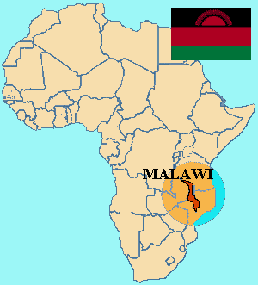
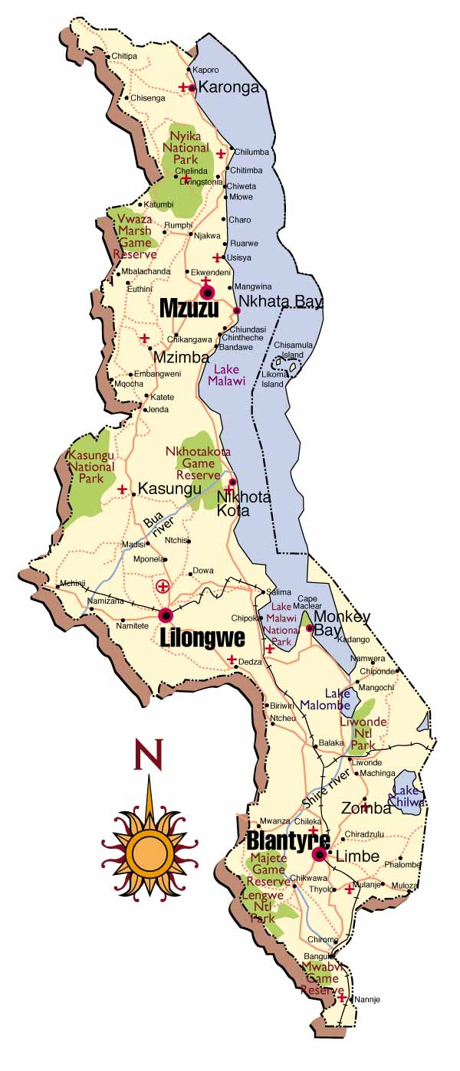
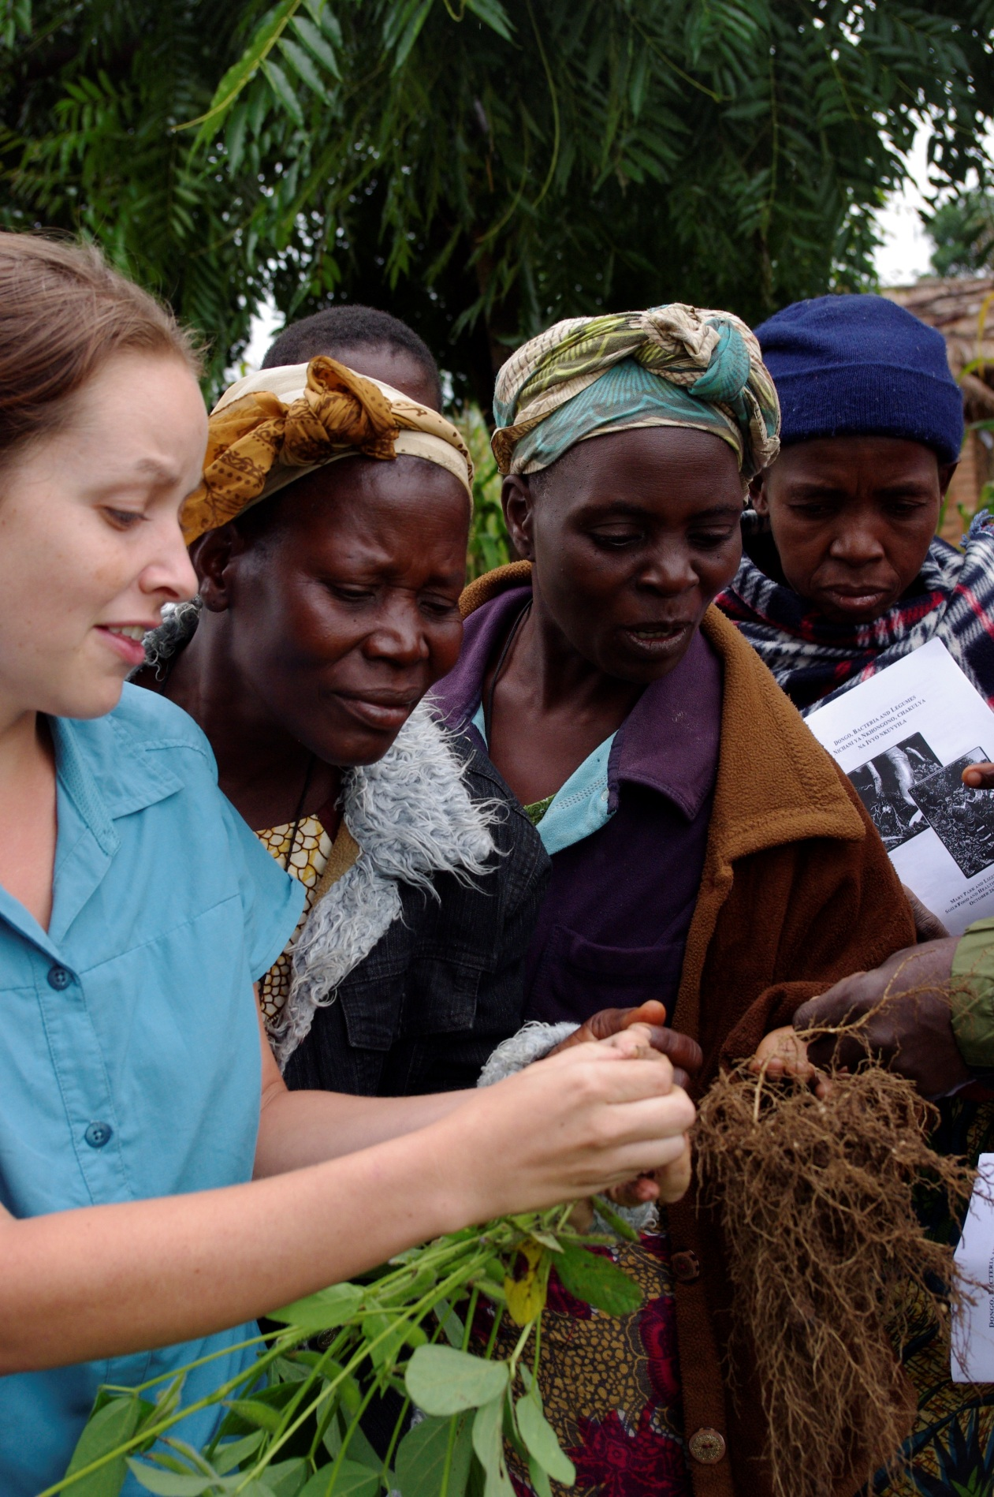
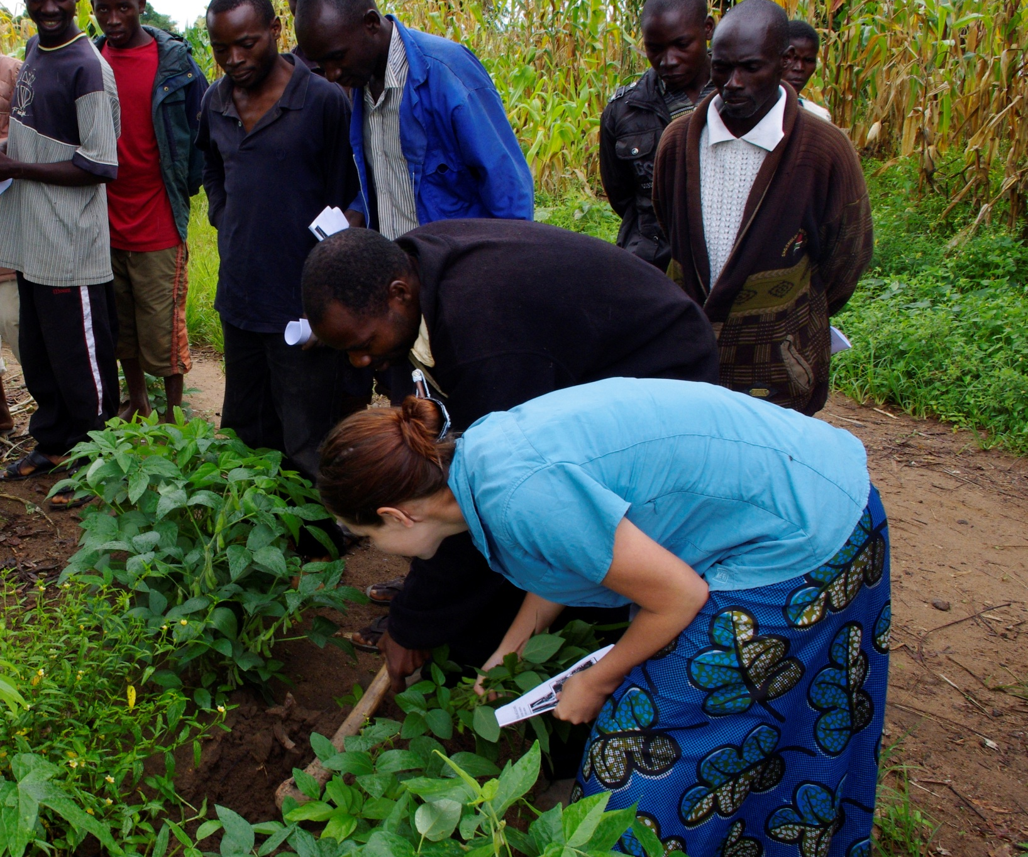
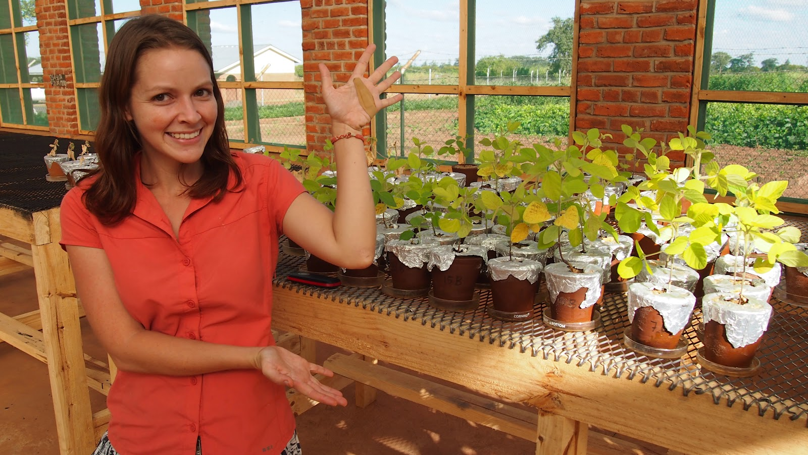
Drivers of Soybean Rhizobia Diversity in Un-inoculated Soils of Smallholder Farms in Malawi.
Parr M¹, Shumba L², Snapp S³, and Grossman J¹.
1. Department of Soil Science, North Carolina State University, Campus Box 7619, Raleigh NC 27695
2. Soils Food and Healthy Communities, Ekwendeni Mission Hospital, Ekwendeni Malawi.
3. W.K. Kellogg Biological Station, Michigan State University, East Lansing, MI 48824
Introduction
Soil Analysis
Molecular Analysis
Legumes, due to their symbiotic association with nitrogen fixing Rhizobia bacteria, are integral to maintaining soil fertility, balancing human nutrition, and productive cropping systems in low input subsistence cropping systems in Malawi. Increasing
All soil samples were analyzed for extractable phosporous (P) using the Mehlich 3 procedure, particle size distribution using the hydrometer method, as well as % organic matter by loss on ignition at 500C in a muffle furnace.
Molecular fingerprinting was conducted on cells grown in liquid culture using repetitive element polymerase chain reaction(rep-PCR) using the BOX A1R primer. PCR products were separated using gel electrophoresis in a 3% agarose gel run at 80 v for 18 hours. Resulting images were analyzed using GelCompar II software (Applied Maths).
Strains found in the native soil (bottom left) were more related to one another than those found in either cultivated soil.
Isolates in the native soil cluster into 2 distinct groups representing slow and fast-growing isolates
legume production requires the presence of appropriate rhizobia partners. While native rhizobia populations exist in most soils, the diversity of these populations varies widely and it is difficult to predict whether there will be
Dendrogram of strains collected from Soil 1, history of legume production
significant numbers capable of nodulating a particular legume crop. In recent years soybean in Malawi has been increasing as an economically and nutritionally important crop, Particularly in the Ekwendeni region in northern Malawi, where the agricultural outreach program “Soils Food and Healthy Communities“ has been promoting legume production. However without a history
of soybean production, significant populations of rhizobia capable of nodulating soybean are unlikely to exist in most soils, and inoculation technology with known, efficient strains is not available to most smallholder farms.
Dendrogram of strains collected from Soil 2, history of non-legume (maize) production
Slow Growing
The purpose of this project is to reveal the environmental drivers of diversity in soybean-nodulating-rhizobia in un-inoculated soils, and use this information to improve nodulation and BNF of soybean grown on resource-limited farms.
Fast Growing
Dendrogram of strains collected from Soil 15, history of native, un-cultivated soil
Soil Sampling and Rhizobia Trapping
Preliminary Conclusions
In collaboration with Soils Food and Healthy Communities, soil samples were collected from 39 farms in the regions surrounding Ekwendeni. Soils were collected with a 2 cm diameter soil probe from the top 15 cm of planting ridges 20 cores were taken from each field and pooled. Equipment was cleaned between samplings. Farmers were interviewed to determine field history for each site and then classified as follows: Non-legume cultivation, Legume (non-soybean) cultivation, Soybean cultivation, or non-cultivated native vegetation.
An inoculant was created from each sample by mixing 10 g soil with 40 ml 0.85% NaCl. 5 ml of slurry were inoculated onto sterilely grown soybean seedlings that were watered with a sterile N-free nutrient solution. Nodules were harvested 6 weeks after inoculation.
Soils varied in extractable P from 2 – 112 mg kg⁻¹ soil, OM from 0 – 7.5% and clay content from 4% to 44%, however, these variables were independent of past cropping history.
Soils from fields with a history of legume production, soya or otherwise resulted in a greater number of nodules per plant than the soils without a history of legume cultivation
Rhizobia isolates have been found to vary widely in morphology and growth rate, as well as molecular fingerprints
Chilida
Enkongolweni
Chisangano
Baula
Zombwe
Luhomero
Ekwendeni
N
Bwabwa
Further Research
Enyezini
Multivariate analysis of both molecular and soil analysis data will allow us to understand the drivers of diversity in rhizobia populations
Muli-locus sequencing of constitutive and symbiotic genes on a subset of unique isolates will allow us elucidate phylogeny of these native rhizobia, as well as community structure
Distribution of field sites around Ekwendeni
Acknowlegements
Soils Food and Healthy Communities,
Anne Turner and the N2Africa project at the N2 Africa project of IITA and
Patson Nalivata and the staff at Bunda College of Agriculture

